Slide 1
Amazon Music Clustering

Slide 2
agenda
Introduction
Business Use Cases & Objectives
Data Understanding & Preprocessing
Clustering Methodology
Conclusion

Slide 3

INTRODUCTION
This project focuses on analyzing and grouping songs from amazon music using machine learning techniques. By applying clustering algorithms like K-Means and DBSCAN, songs are grouped based on their musical features such as danceability, energy, tempo, valence, and loudness.
The main goal is to discover patterns and similarities between songs so that we can create meaningful clusters. This helps in better playlist recommendations, user experience enhancement, and trend analysis in the music industry.

Slide 4

OBJECTIVES
The main objective of this project is to group songs with similar musical characteristics using clustering techniques. By analyzing features such as danceability, tempo, energy, and valence, the project aims to: identify hidden patterns and similarities among songs.
Create clusters that represent different moods or genres.
Help in automatic playlist creation and music recommendation.
Provide insights for artists, listeners, and music platforms to understand audience preferences.

Slide 5
Data Understanding & Preprocessing
Raw Data ➜ Cleaned Data ➜ Engineered Features ➜ Scaled Data
1. RAW & CLEANED DATA DETAILS:
Metric | Value
Total Songs | 95837
Columns Before Cleaning | 23
Columns After Cleaning | 11
Missing Values | Removed

Slide 6
Original column: duration_ms (milliseconds)
2. FEATURE ENGINEERING
To create new informative features that better represent a song’s characteristics and improve clustering quality.
Steps Involved:
*Duration Conversion
Original column: duration_ms
Converted to duration mile second = duration_ms/1000
(Makes duration more interpretable for energy-based ratios)
*Energy Per Second
energy_per_sec = duration_seconds / energy​
(Represents how much energy a song maintains per unit time — helps separate short, intense tracks from long, calm ones)

Slide 7
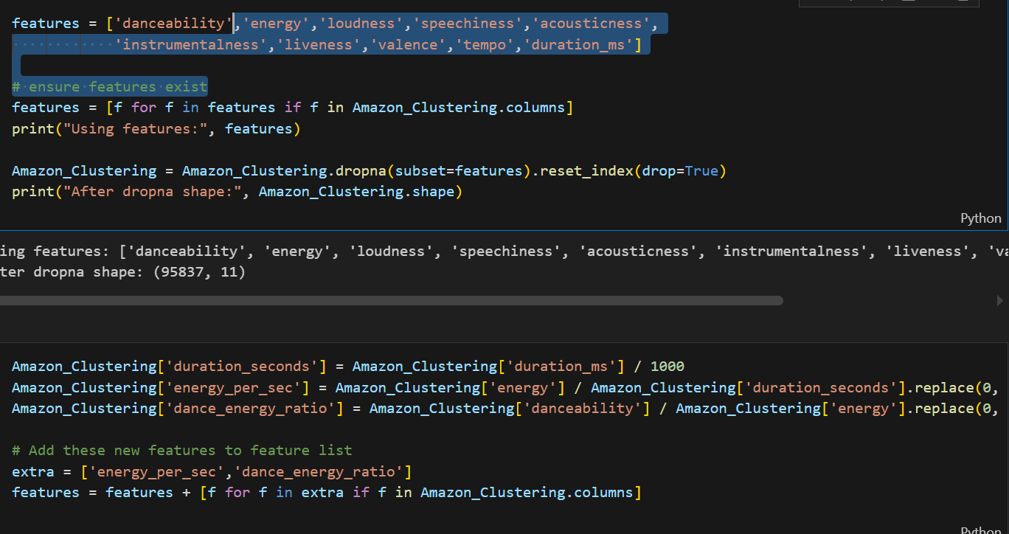
Dance-Energy Ratio
dance_energy_ratio = danceability / energy
(Captures how “danceable” a song is relative to its energy level — useful for identifying upbeat vs. chill tracks)
Feature engineering was performed to create more meaningful metrics.
For example, “energy_per_sec” normalizes song energy by length, while “dance_energy_ratio” helps identify dance-focused songs.
These features help clustering algorithms group songs more accurately by mood and style.

Slide 8
3.SCALED DATA
We used MinMaxScaler to normalize all audio features between 0 and 1.
This step ensures fair comparison between features like energy, tempo, and danceability.
Without scaling, clustering results would be biased toward high-value feature
from sklearn.preprocessing import MinMaxScaler
X_scaled = MinMaxScaler().fit_transform(X)
Min Max Scaler Formulae:
Min Max Scaler = X – X min / Xmin – Xmax
To bring all numerical features onto a common scale so that no single feature dominates the clustering process.

Slide 9
CLUSTERING METHODOLOGY
K-means clustering
The k-means clustering algorithm was the primary technique applied in this project to group amazon music songs based on their audio characteristics. K-means is a partition-based clustering method that organizes data into k clusters, where k represents the number of distinct groups defined by the user. Each cluster is represented by a centroid, which is the mean of all data points within that group. The algorithm begins by randomly initializing k centroids and then iteratively updates them to minimize the sum of squared errors (SSE) between each data point and its assigned centroid. The objective is to ensure that songs within the same cluster share similar properties, while those in different clusters are distinctly separated.
To find the optimal number of clusters, this project used both the elbow method and the silhouette score. The elbow method plots the SSE against varying k values, identifying the “elbow point” where improvement slows down. The silhouette score measures how well a song fits into its cluster compared to others, with higher scores indicating well-defined clusters. Once the best k value was determined, the k-means model was trained using scaled features such as danceability, energy, and tempo. Each resulting cluster represented a unique group of songs sharing common musical moods or energy patterns, supporting automated playlist curation and genre grouping.

Slide 10
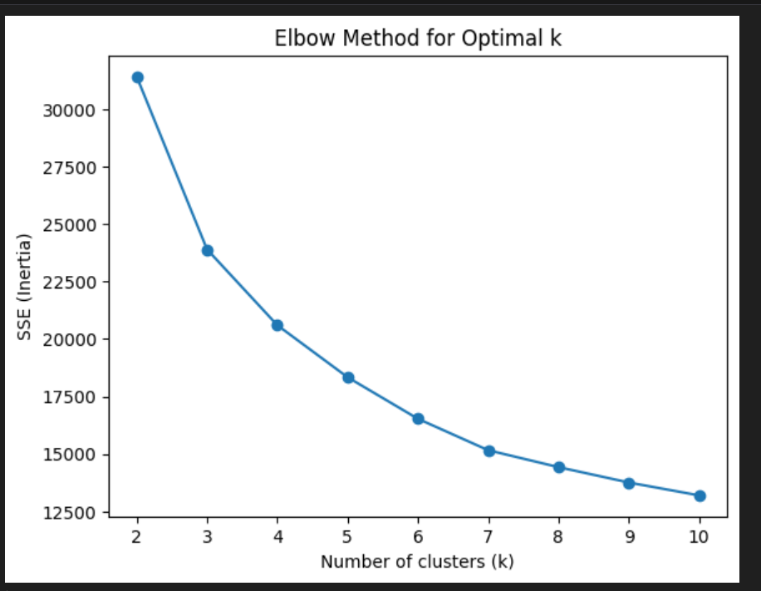
ELBOW METHOD
We tested different k values from 2 to 8 using the Silhouette Score.
The highest score (0.3202) was achieved when k = 3, meaning the dataset naturally forms three well-defined clusters representing different music groups or moods.

Slide 11
DBSCAN Clustering
DBSCAN (Density-Based Spatial Clustering of Applications with Noise) was applied as an alternative clustering method to validate and complement the K-Means results. Unlike K-Means, DBSCAN does not require specifying the number of clusters beforehand; instead, it forms clusters based on the density of data points. This makes it particularly effective for datasets containing irregular shapes, variable densities, or noise — which are common in real-world music data. DBSCAN groups songs that are closely packed together in feature space and labels points in low-density regions as noise or outliers.
The algorithm uses two key parameters: eps (ε), which defines the maximum distance between two samples to be considered neighbors, and min_samples, which specifies the minimum number of songs required to form a dense region. Songs meeting these conditions become core points, while others may be border points or noise. In this project, DBSCAN helped detect songs that didn’t fit well into any K-Means cluster, identifying unique or niche musical styles. It also revealed naturally formed clusters that varied in size and shape, demonstrating flexibility beyond K-Means’ spherical boundaries. Overall, DBSCAN provided a deeper understanding of underlying song relationships, improved cluster interpretation, and enhanced the reliability of the final analysis by handling noisy or outlier data effectively.

Slide 12
VISUALIZATION
PCA
Bar Chart
Heat Map
Distribution Plot

Slide 13
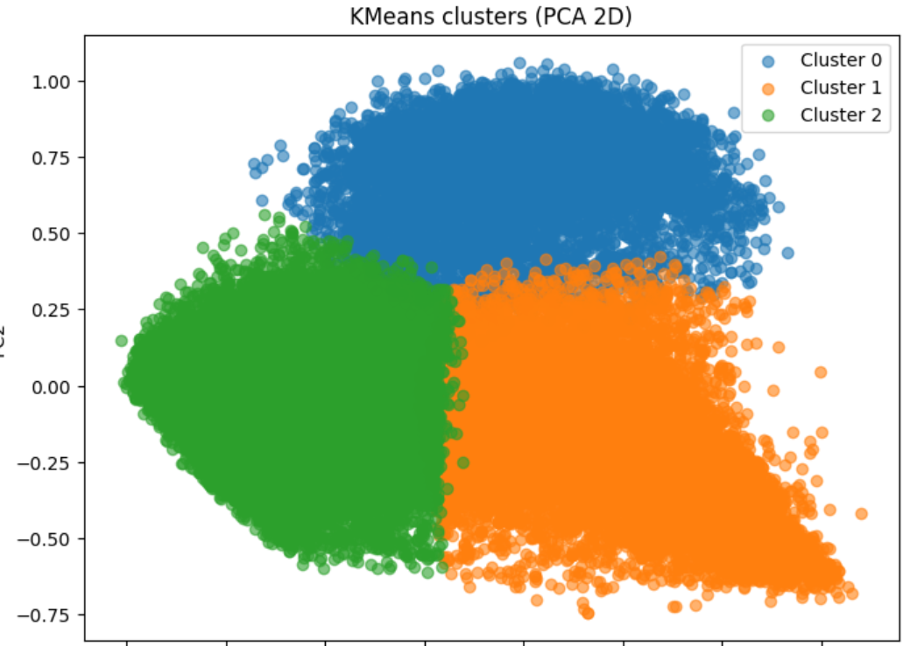
1.PCA
PCA was used to reduce high-dimensional data into 2 or 3 components while preserving most of the variance.
Each point in the PCA scatter plot represents a song, and the colors represent clusters formed by k-means.
This helps us see clear separation or overlap among music clusters, identifying patterns like energetic vs calm songs.

Slide 14
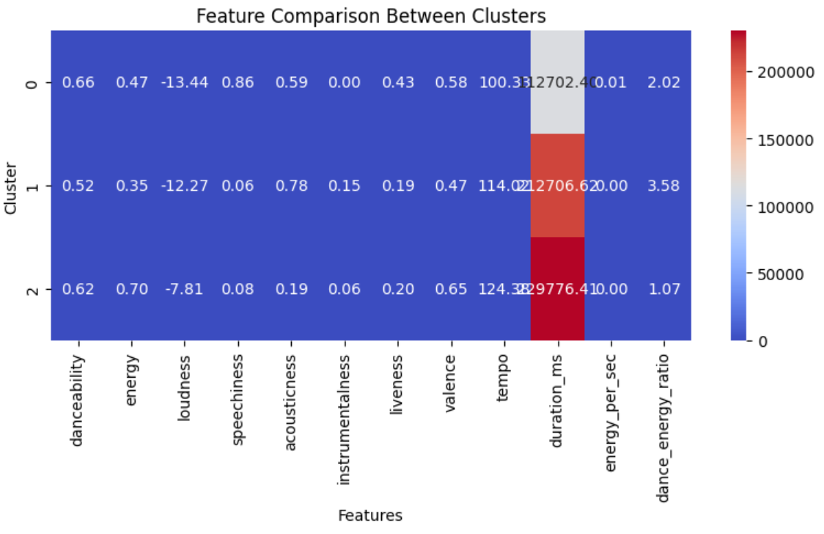
2.Heatmap
A heatmap visually shows the average feature values per cluster.
It helps us compare clusters based on characteristics like energy, tempo, and danceability.
Each row represents a cluster, and each column represents a feature.
The color intensity indicates the value — for example, darker shades for higher energy or tempo.
It helps interpret what makes each cluster unique (eg: Cluster 1 = energetic songs, cluster 2 = acoustic songs).

Slide 15
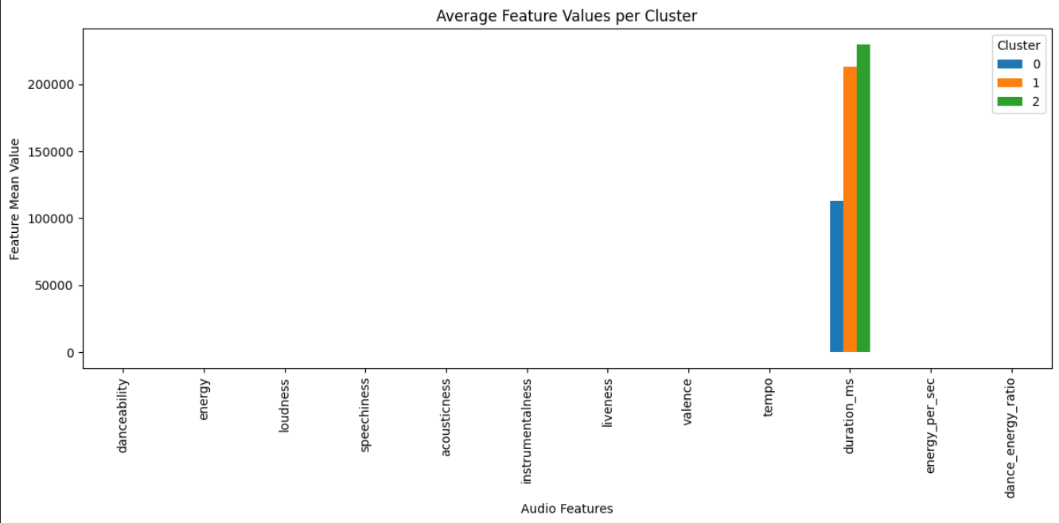
3.Bar Chart
Bar charts summarize average feature values for each cluster.
They provide a simple way to compare how features vary between clusters.
A bar chart shows mean values (e.g, Average danceability, tempo, energy) for every cluster.
It helps identify the dominant features in each group — for instance, cluster 0 might have high danceability and tempo, representing upbeat songs.

Slide 16
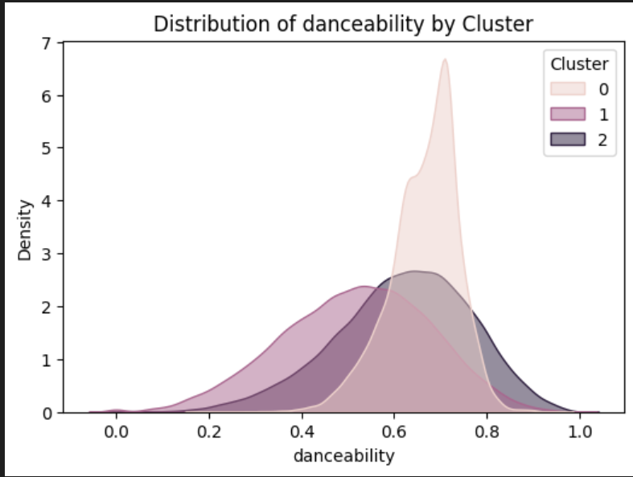
4.Distribution Plot
Distribution plots (like histograms or KDE plots) show the spread of a single feature across clusters.
We plotted distributions of features like danceability, tempo, and valence.
This helped analyze how each feature is distributed among clusters — for example, some clusters may have more slow-tempo songs, while others have higher energy.

Slide 17

Conclusion
The project grouped songs based on their audio features using K-Means clustering, forming three distinct music clusters. PCA, heatmaps, and bar charts helped visualize and understand song similarities. This clustering approach can support automatic playlist creation, music recommendations, and listener mood analysis.

